Slide 1
Utilizing Integrated Behavioral Health to Improve Chronic Health Conditions
Laurie Smith, LMSW, CDE
Learning and Action Network Webinar
Nov. 9, 2017

Slide 2
Utilizing Integrated Behavioral Health To Improve Chronic Health Conditions Laurie Smith, LMSW, CDE Behavioral Health Care Manager Medical Network One Health Solutions lsmith@mednetone.net

Slide 3
Objectives
Define how behavioral health factors and social determinants of health impede or enhance chronic disease health outcomes
Explore how an embedded behavioral health care specialist, cross trained in disease management, can optimize health outcomes, improve patient and provider satisfaction, and drive quality scores
Identify strategies to make this work in your practice

Slide 4
https://www.youtube.com/watch?v=c8ueviWMN1A
Cost Savings of Treatment of Medically Unexplained Symptoms Using Intensive Short-term Dynamic Psychotherapy (ISTDP) by a Hospital Emergency Department, Abbass, et all
In the year following treatment, there was a 69% reduction in ED visits by these patients at an average cost reduction of $910 per patient. ISTDP interventions averaged 3.8 sessions costing approximately $406 per patient.

Slide 5
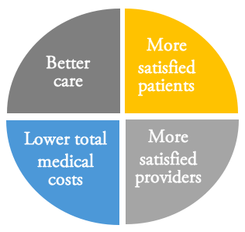
Quadruple Aim

Slide 6
Sources: ¹McGinnis JM et al. JAMA 1993; 270:2207-12. ²Mokdad AH, et al. JAMA 2004; 291:1230-1245.

Slide 7
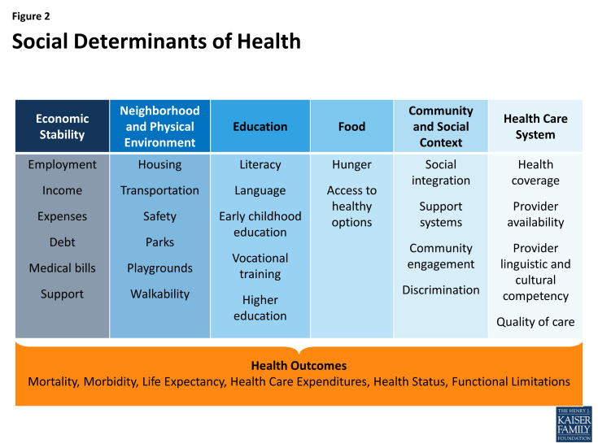
Social Determinants of Health

Slide 8
Psychological Factors
Health Behaviors
Health Beliefs
Self-Efficacy
Trust/Mistrust of the Health System
Stress

Slide 9
Prevalence
Behavioral Health is Highly Prevalent in Primary Care
84% of the time, the 14 most common physical complaints have no identifiable organic etiology¹
80% of individuals with a behavioral health disorder will visit primary care at least 1 time in a calendar year²
50% of all behavioral health disorders are treated in primary care³ (92% with elderly)
20-40% of primary care patients have behavioral health needs⁴
48% of the appointments for all psychotropic agents are with a non-psychiatric primary care provider⁵ (up to 80% of antidepressants)
Sources: ¹Kroenke & Mangelsdorf, Am J Med. 1989;86:262-266. ²Narrow et al., Arch Gen Psychiatry. 1993;50:5-107. ³Kessler et al., NEJM. 2006;353:2515-23. ⁴Martin et al., Lancet. 2007; 370:859-877. ⁵Pincus et al., JAMA. 1998;279:526-531.
Notes:
Sources: ¹Kroenke & Mangelsdorf, Am J Med. 1989;86:262-266. ²Narrow et al., Arch Gen Psychiatry. 1993;50:5-107. ³Kessler et al., NEJM. 2006;353:2515-23. ⁴Martin et al., Lancet. 2007; 370:859-877. ⁵Pincus et al., JAMA. 1998;279:526-531.

Slide 10
Prevalence of Mental Health Conditions in Primary Care
Psychiatric disorders prevalence
Major Depression 10 to 24%
Panic Disorder 6 to 16%
Other Anxiety Disorders 7 to 21%
Alcohol Abuse 7 to 17%
Any Psychiatric Diagnosis 28 to 52%
Depression is 2nd most common illness after hypertension
Notes:
Primary care is where pts show up

Slide 11
Unmet Behavioral Health Needs
67% of individuals with a behavioral health disorder do not get behavioral health treatment¹
30-50% of referrals to behavioral health from primary care don’t make first appt^{2,3}
Two-thirds of primary care physicians reported not being able to access outpatient behavioral health for their patients⁴ due to:
Shortages of mental health care providers
Health plan barriers
Lack of coverage or inadequate coverage
Depression goes undetected in >50% of primary care patients⁵
Only 20-40% of patients improve substantially in 6 months without specialty assistance⁶
Sources: ¹Kessler et al., NEJM. 2005;352:515-23. ²Fisher & Ransom, Arch Intern Med. 1997;6:324-333. ³Hoge et al., JAMA. 2006;95:1023-1032. ⁴Cunningham, Health Affairs. 2009; 3:w490-w501. ⁵Mitchell et al. Lancet, 2009; 374:609-619. ⁶Schulberg et al. Arch Gen Psych. 1996; 53:913-919
Notes:
Why do they go “unmet? STIGMA!
Sources: ¹Kessler et al., NEJM. 2005;352:515-23. ²Fisher & Ransom, Arch Intern Med. 1997;6:324-333. ³Hoge et al., JAMA. 2006;95:1023-1032. ⁴Cunningham, Health Affairs. 2009; 3:w490-w501. ⁵Mitchell et al. Lancet, 2009; 374:609-619. ⁶Schulberg et al. Arch Gen Psych. 1996; 53:913-919

Slide 12
10 Most Common Complaints in Adult Primary Care
Chest Pain
Fatigue
Dizziness
Headache
Back Pain
Swelling
Insomnia
Abdominal Pain
Numbness
Shortness of Breath
Only 10 to15% had identifiable organic basis
Kroenke & Mangelsdorf (1989) Am J Med;
Strosahl et al. (1998); Kaiser; APA

Slide 13
Comorbidities: Depression and other Chronic Conditions
Alzheimer’s 11%
Asthma 45%
HIV 12%
CAD 17%
Stroke 23-40%
MI 25-40%
Diabetes 27%
COPD 40%
Cancer 42%
Parkinson’s Disease 51%
Chronic Pain 52%
Prevlance of Depression with Other Chronic Diseases Percent with Depression (Saleem, J, Depression in Patients with Medical Comorbidities, 2016; Iyer, A.S. et al., Deprssion Associated with Readmission for Acute Exacerbation of COPD, AnnalsATS Vol 13#2, 2016 Pincus HA. J Clin Psychiatry. 2001;62 Suppl 6:5-9; Schatzberg AF. J Clin Psychiatry. 2004;65 Suppl 12;3-4.)

Slide 14
Common Chronic Medical Conditions that Have Significant Behavioral Health Components
Pain
Hypertension
Asthma
Diabetes
Sleep disorders
HIV
Cardiovascular Disease
Irritable Bowel Syndrome
Obesity
Sexual Dysfunction

Slide 15
Depression and Diabetes
80% of increased cost are medical, not behavioral
Excessive hunger, abnormal thirst, shakiness, blurred vision are more than doubled. Feeling faint and daytime sleepiness nearly five fold (Malek, Norris, 2008)
Poor self-care increases acute healthcare episodes
Depressed and anxious patients consume up to 4 times more medical resources
Depression is more predictive of negative outcome for most other chronic diseases than the severity of the other diseases themselves!

Slide 16
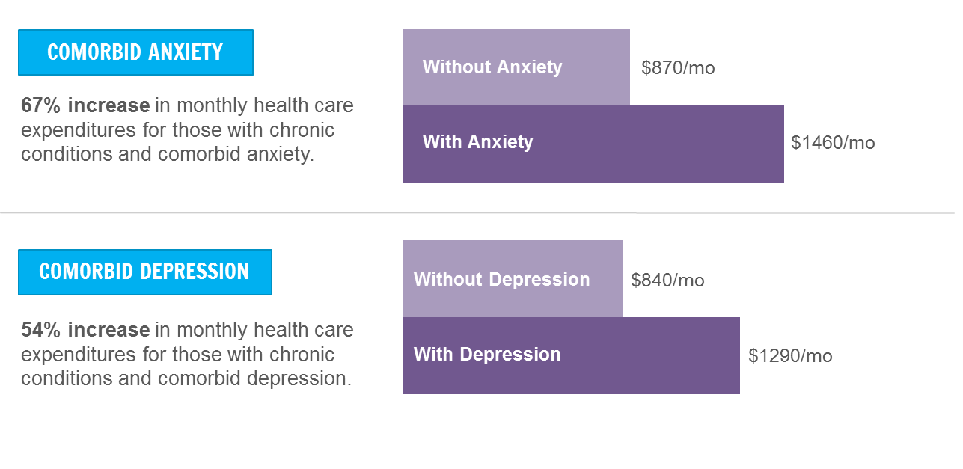
Increased Costs
Chart: Research Synthesis Report No. 21 | The Robert Wood Johnson Foundation | Mental disorders and medical comorbidity | February 2011

Slide 17
Annual Medical Expenditures for Adults with and without a MH Condition
 | Cost without mental health condition | Cost with mental health condition
All adults * | $1,913 | $3,545
Heart condition | 4,697 | 6,919
High blood pressure | 3,481 | 5,492
Asthma | 2,908 | 4,028
Diabetes | 4,172 | 5,559
*Refers to all adults with and without chronic conditions. . Information from U.S. Department of Health and Human Services. The 2002 and 2003 MEPS. AHRQ, Rockville, Md.

Slide 18
Improved Outcomes and Lower Costs With BH Integration
Medical use decreased 15.7% for those receiving behavioral health treatment while medical use increased 12.3%¹ for controls who did not receive behavioral health treatment
Depression treatment in primary care for those with diabetes resulted in $896 lower total health care cost over 24 months²
Depression treatment in primary care resulted in $3,300 lower total health care cost over 48 months³
Resulting in a return of $6.50 for every $1 spent
Multi-condition collaborative care for depression and diabetes saved $594 per patient over 24 months.⁴
Sources: ¹Chiles et al., Clinical Psychology. 1999;6:204–220. ²Katon et al., Diabetes Care. 2006;29:265-270. ³Unützer et al., American Journal of Managed Care 2008;14:95-100. ⁴Katon et al. Arch Gen Psych, 2012:69:506-514

Slide 19
The addition of psychological interventions for Kaiser clients with serious medical disorders resulted in:
77.9% reduction in their average length of hospitalization
66.7% reduction in hospitalization frequency
48.6% decrease in number of prescriptions written
48.6% decrease in physician office visits
45.3% decrease in emergency room visits
31.2% decrease in telephone contacts.
R. Lechnyr, EAP (Employee Assistance Program) Digest), 1999 Nov/Dec.

Slide 20
Meeting Patients Where They Are: Reducing stigma against seeking mental health care
Integrated Care for Medical Conditions
• Diabetes/BP/Obesity
• Heart Disease
• Childhood Chronic Illness
• Stress-linked Physical Symptoms
Integrated Care for
Mental Health Conditions
• Depression/Anxiety
• Substance Abuse
• ADHD
• Other
Integrated Care for Persons: Social and Care Complexity
Functional impairments or diagnostic uncertainty
Distress, distraction & readiness to engage in care
Social safety, support & participation
Organization of care / relationships in health system
Shared language with providers / sufficient insurance
Source: CJ Peek & Mac Baird, 2010

Slide 21
How do we do this? Integrated Care Models
Consultative Model/PCMH-N
Psychiatrists/Therapist sees patients in consultation in his/her office – away from primary care
Co-located Model
Psychiatrist/Therapist sees patients in primary care
Collaborative Model
Psychiatrist/Therapist provides caseload consultation about primary care patients; works closely with primary care providers (PCPs) and other primary care-based behavioral health providers (BHP)
Source: http://uwaims.org

Slide 22
PCMH Behavioral Health Care Management
Patient Centered Care – whole person care
Integrated
Meeting the person where they are
Impossible to separate behavioral component from health component
Jim: Type 1 hypoglycemia, prevention of ER visits
Kathy: Obese, CHF, DM2, heart valve replacement, depression
Insulin starts/restarts

Slide 23
Psychological Factors
Health Behaviors
Health Beliefs
Self-Efficacy
Trust/Mistrust of the Health System
Stress

Slide 24
PCMH Behavioral Health Care Management
Team-based care
PCP able to focus on what they do best
Physician consultation
Mental Health support
Engagement with patients and family members
Office In-services (anxiety, depression, medications, etc.)

Slide 25
PCMH Behavioral Health Care Management
Population-Health Management
close gaps in care, routine screenings, preventative maintenance (mental and health), patient handouts, etc.… move towards proactive vs. reactive care
ADT’s/Transitions of Care

Slide 26
PCMH Behavioral Health Care Management
Enhanced Access
On-site brief intervention. Most patients referred to mental health services don’t go. “The grey area”
2-way coordination with community resources, schools, specialty mental health (Suicidal patient, APS)
Development of Community Resource book/Relationships – PCMH-N

Slide 27
PCMH Behavioral Health Care Management
Payment for Added Value
Assessment and Intervention for mental/behavioral health, substance abuse and misuse/abuse and health behavior change. PHQ-2’s, etc.
Improve acute and long-term outcomes, patient and provider satisfaction, decrease monthly costs for enrolled population, decrease ER visits and prevent/decrease hospitalizations (both medical and psychiatric) – 15% reduction in ER visits this year

Slide 28
PCMH Behavioral Health Care Management
Care Management and Support – value and risk based (what the patient needs and when). Address population and individual health behaviors. Offer self management support.
Diabetes Prevention/Group Visits
ADHD medication follow-ups
Asthma flare-ups, anxiety, high/low BG, food insecurities, etc.

Slide 29
PCMH Behavioral Health Care Management
Care Coordination and Transitions of Care – Assessing social determinants of health, health literacy, medication management, etc. and action planning to reduce readmission.
ER pain medications
Pharmacies, Specialists, Community Resources, etc.
Reducing Barriers (transportation, costs, support, SUD, etc.)

Slide 30
PCMH Behavioral Health Care Management
Performance Measurement and Quality Improvement Strategies
Program development, evaluation, treatment and follow-up protocols (PDSA’s, practice education, staff support/education, corrective action plans, etc.)
CAPHS, MIPCT/SIMS, HEDIS, etc.
A1c’s <7 from 23% to 40% improvement

Slide 31
Examples
Group Visits
Improve quality of care and clinical outcomes
Provide another option for patient access
Raise patient and provider satisfaction
Improve efficiencies and control costs
Peer support
Increase patient understanding of disease/condition
Address medical and psychosocial issues

Slide 32
Examples
Diabetes Prevention Program
5-7% weight loss over 12 months
Increased physical activity to 150 minutes/week
Pt engagement leads to prevention of diabetes, reduced medical costs
Chronic Disease Self Management Programs: Diabetes, Chronic Pain, etc.
Anxiety, Depression, Stress Management, etc.

Slide 33
Case Example
Susan
CVD, DM for 15+years, obese, lower leg edema, neuropathy, possible skin cancer. Areas addressed: medication adherence (using insulin adequately), nutrition, physical activity, obtaining preventative exams and addressing skin lesion (addressing fears), utilizing specialists when needed to avoid hospitalization (foot care, cardiologist) using Motivational Interviewing, Brief Action Planning, Cognitive Behavioral Therapy, Strengths-Based Interventions and utilizing patient’s spiritual beliefs and family support. A1c from 9.1 to 7.9

Slide 34
Case Example
Derek
34 Bipolar Disorder other mental health impairments, Diabetes, Asthma. Low health literacy. Excessive ER visits (5 in 3 mths) due to transportation. Result: Self-advocacy, new PCP. Brief Action Planning, Problem-solving, Motivational Interviewing. A1c = 7, hospitalizations in past 6mths: 0

Slide 35
Case Example
‘Dwayne’
56yr, CHF, previous hospitalizations, new onset DM, morbid obesity, cellulitis of lower limbs, hypertension, cholesterol, suicidal. BG 100’s-600 pp. Results: decreased suicality, medication adherance, cellulitis improved, no further hospitalizations.

Slide 36
Our Office
CPC+: Standardized PHQ’s this year – all patients screened yearly, follow-up w/BH Care Manager if necessary
100 referrals
80 follow-ups scores
90% have improved
Increase in medication usage when necessary
2-6 visits (phone or in-person)

Slide 37
Considerations
What’s your goal? What do you want to accomplish?
Who is your target population?
How will they be identified?
Perform a needs analysis
Determine available financial mechanisms

Slide 39
Funding
Multiple avenues for compensation!
Healthcare delivery is moving towards team-based care – ie. Care Management which practices will be compensated for
Multiple codes exist for this care delivery (H&B, HICM, PDCM, etc.)
How much is YOUR time worth to deliver person-centered care in order to reduce costs, improve health outcomes, improve patient satisfaction and improve YOUR job satisfaction?
We can help reduce your burden while improving care!

Slide 40
How do you get one?
ACO
PO
Health System
Build the case: it’s all about the downstream cost savings

Slide 41
Moving Forward…
What does this look like for you?
What are your next steps?
What will you do this week towards improving your behavioral health outcomes?
SMART Goals

Slide 42
Q & A

Slide 43
References
Melek et al., Economic Impact of Integrated Medical-Behavioral Healthcare, Milliman 2014
Klein and Hostetter, In Focus: Integrating Behavioral Health and Primary Care, Quality Matters Archive, The Commonwealth Fund Sep 2014
Gerrity M., Evolving Models of Behavioral Health Integration, Evidence Update 2010-2015, The Milbank Memorial Fund, May 2016

Slide 44
Thank You!
Follow us online
@LakeSuperiorQIN
This material was prepared by Lake Superior Quality Innovation Network, under contract with the Centers for Medicare & Medicaid Services (CMS), an agency of the U.S. Department of Health and Human Services. The materials do not necessarily reflect CMS policy. 11SOW-MI-G1-17-83 101217

